Slide 1
Calvert County Best Practices
October 24, 2019
Karen Lane, Chair
410.980.7814
k.lane@calfam.org
www.calfam.org

Slide 2
Outline
Grab & Go Brief
Outreach & Fundraising
Final Thoughts

Slide 3
Part I: Grab & Go Brief Tailored for the Board of Calvert County Commissioners

Slide 4
The Need
Calvert County is one of the wealthiest counties in the nation, with a median household income of $100,350⁽¹⁾, however
In 2018, 311 homeless heads of households applying for services cited Calvert County as their last address (household size 1 to 11 persons)⁽²⁾
During the 2018-2019 school year, 220 children qualified as homeless as defined by the McKinney-Vento Homeless Assistance Act
One-third of Calvert families are at poverty level or earn less than the basic cost of living for our county⁽³⁾
2018 estimate from the American Community Survey, U.S. Census Bureau
2018 Survey of Services to Homeless Persons in Calvert County, Calvert County Department of Community Resources
2017 United Way ALICE (Asset Limited, Income Constrained, Employed) Report

Slide 5
Purpose
Promote awareness of Calvert Family Advocates’ role in addressing key areas of need in advance of state-wide social services conference to be held in Solomons

Slide 6
Introduction
Advisory Board is a member of the Maryland Association of Social Services Boards (MASSB)
MASSB Foundation 501(c)3
Calvert Family Advocates (CFA) is a component fund of MASSB Foundation

Slide 7
Calvert Family Advocates
Mission is to improve lives of Calvert County’s most vulnerable citizens by helping them help themselves
Fundraise to “close the gaps”
Accepts referrals from Dept. of Social Services and Calvert County Public Schools
Model for state, local, nonprofit collaboration

Slide 8
Distribution of Funds*
*Percent of Expenditures
Notes:
We organize our budget around these 4 areas.
The areas which were selected based on the insight we have as members of the Advisory Board and a larger network that includes the Office on Aging, Calvert County Public Schools, Homeless Services Board, Tri-County Veterans Interdisciplinary Team Committee
I’ll provide just a brief description of these programs:
Safety: Homeless prevention (rental and mortgage arrearages), deposits and first month’s rent, furnace repairs and fill oil tanks, critical medical/oral needs
Self-sufficiency: education and job training, transportation and other barriers to employment
Eldercare: Medical expenses, assistive devices and safe shelter
Youth: Summer camp, grant for new clothing and eyeglasses, and driver’s education. Sponsoring a summer enrichment program for kindergartners at PAC

Slide 9
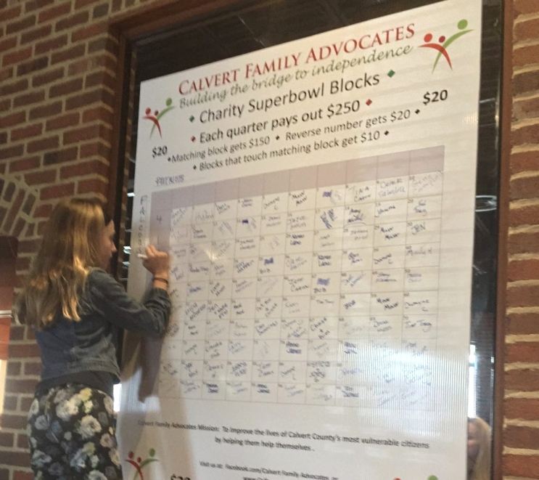
Fundraising
Corporate and individual donations
Grants
Small fundraisers
95% of funds go to programs

Slide 10
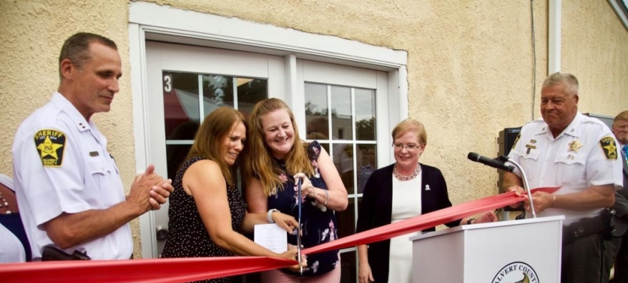
Impact
Since 2014 have provided $300,000 in assistance
Impacted over 250 families and additional 300 children
Raised start-up funding to support opening of the Child Advocacy
Center

Slide 11
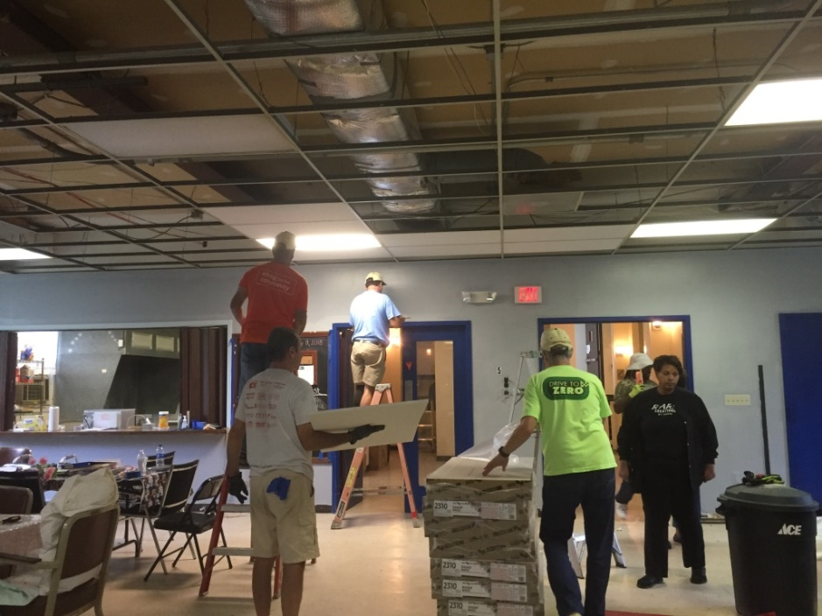
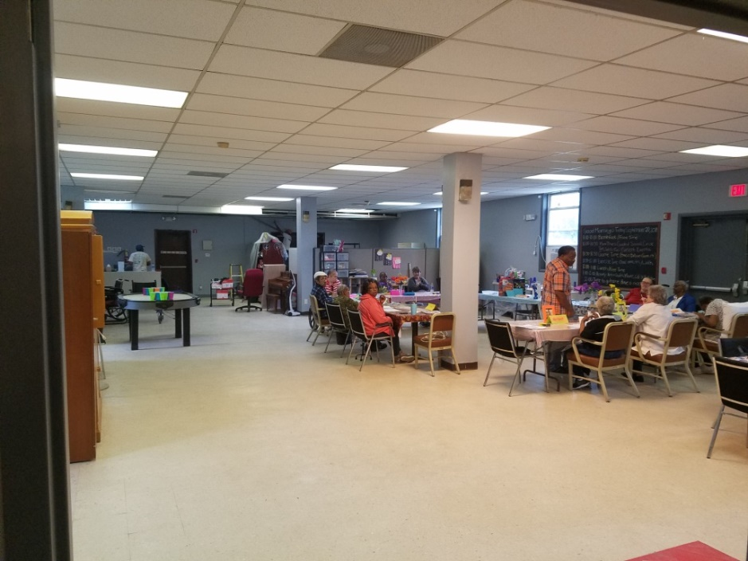
Partnerships

Slide 12
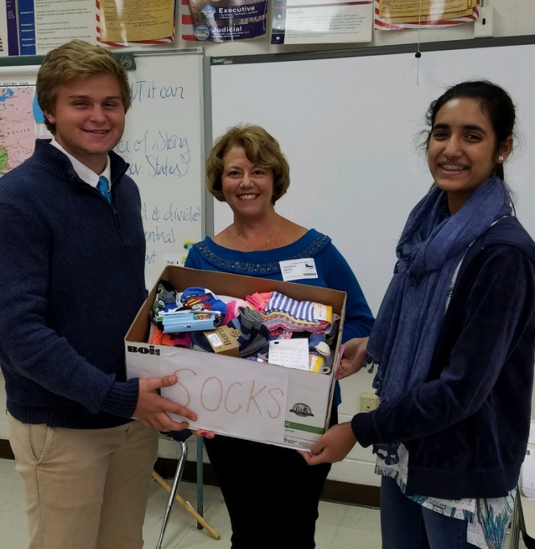
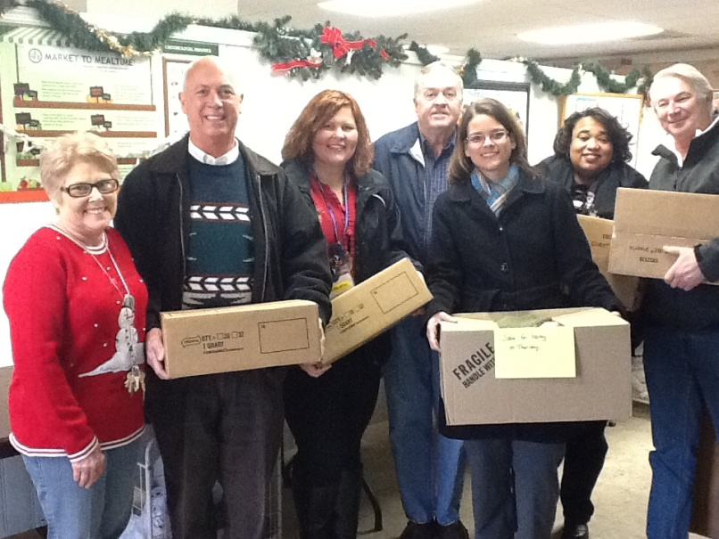
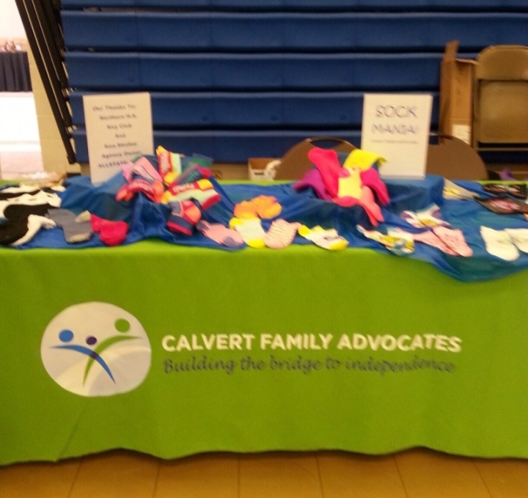
Partnerships

Slide 13
Issues
Affordable Housing
Transportation
Oral Health Care

Slide 14
Future Plans
Continue to work to:
Reduce the number of homeless families
Improve the safety and well-being of residents living in poverty
Improve the ability of at-risk adults to become self-sufficient
Increase opportunities for homeless & at-risk youth
Increase collaboration with like-minded organizations to improve the availability and effectiveness of services

Slide 15
MASSB Conference
Oct 24-25, Hilton Garden Inn, Solomons
Dept. of Human Services Secretary Padilla keynote speaker
PATRIOT to be honored as “Community Partner of the Year”

Slide 16
Summary
Calvert Family Advocates is the nonprofit component of the Advisory Board
We collaborate with state and local agencies; and other nonprofits to help our neighbors live stable and self-sufficient lives
We are a community resource

Slide 17
Part II: Fundraising & Outreach

Slide 18
Fundraising
Super Bowl fundraiser - $1,000/board
Mailing in November - $4,000
Local Thrift Store Grants - $8,000-$10,000
Calvert County Women’s Giving Group
Brew & Q Fundraiser - $7000
Basket Bingo - $7000
Corporate support best option for small boards

Slide 19
Outreach
Donor focused
Chamber of Commerce events (i.e. golf tournament)
Customer focused
Community Resource Fair
Family-friendly community events
Food pantry partnerships

Slide 20
Tools
Strategic Plan
Grab & Go Brief
Statement of Need
Application Process
Photo Release Form
Website
Testimonials
Thank You Letters
Facebook page
Business Cards (donated)
Tablecloth (donated)
Postcards
Flyers
Data/Metrics

Slide 21
Part III: Final Thoughts

Slide 22
Final Thoughts
Build relationships based on trust and respect
Cultivate corporate sponsors
Work smart, not hard
Don’t reinvent the wheel
Biggest challenge – board development!

Slide 23
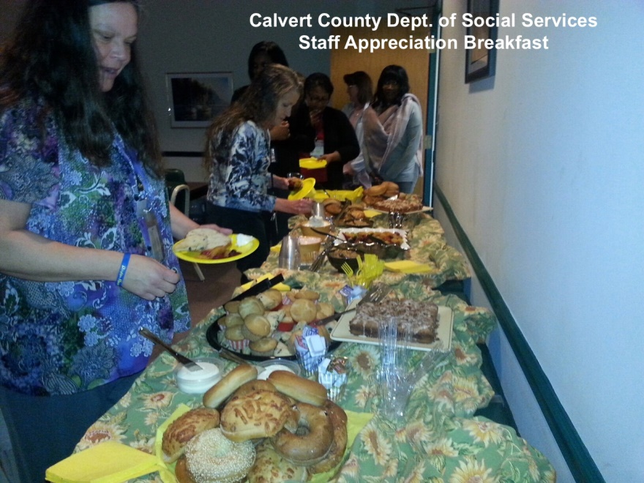
One more thing…
“Ms. Thomas was so excited. Thank you for all you do for our customers! Makes my job rewarding.”
“I just wanted to say how thankful Adult Services is for the help you have provided. You have made such a difference in the lives of our customers and you have provided us with hope – we don’t always have to turn people away because there are no funds.”

Slide 24
Questions? K.Lane@calfam.org

