Slide 1
Annapolis Family Support Center
Baby Boutique
A new and creative approach to increase rates of attendance and engagement in the midst of a pandemic and beyond at the Annapolis Family Support Center.
First some information regarding the Center and its services will be provided to better understand the purpose of the Baby Boutique.
Notes:
Although the AFSC’s Baby Boutique is being nominated I felt it was first important to give some background regarding the AFSC

Slide 2
Annapolis Family Support Center
Mission: To empower families to become self-sufficient through personal achievement, education and positive parenting.
Location: 80 West St. Suite B in Annapolis has been providing quality services for families in the Annapolis community since 1994.
Operated through a partnership between the Anne Arundel County Department of Social Services, Anne Arundel County Government and Maryland Family Network.

Slide 3
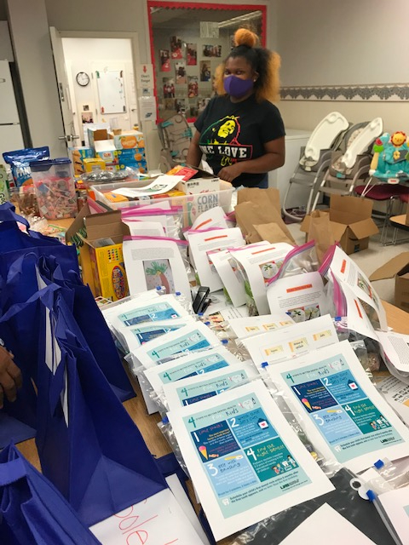
Front End, Community Focused,
Direct Service Programing
The AFSC is a vital program that helps parents finish their education, learn job readiness skills and build solid networks.
By supporting parents and other caregivers through the challenges of raising young children and through early interventions,
AFSC helps raise strong families who have the ability to reach their greatest potential.

Slide 4
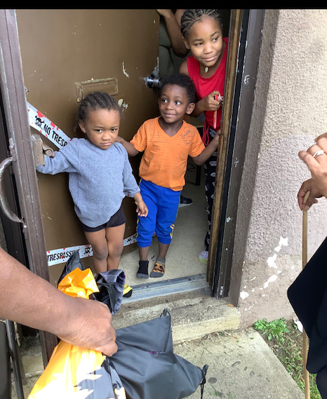
Who We Serve
Services provided to expectant mothers, fathers and legal guardians of children ages 0-3.
The center is currently providing services to 28 participants and 34 children.
The Center’s goal is to provide services to 100 participants and 100 children annually.

Slide 5
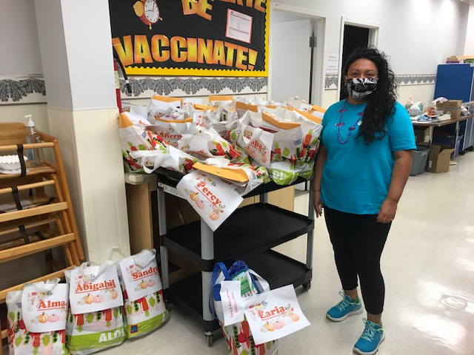
Services Provided
• Self Sufficiency & Leadership Development Programming
• Infant / Toddler Programs
• Home Visiting
• Health Education
• Outreach, Collaboration & Service Coordination
• Parent Education
Notes:
-Self Sufficiency Programming: English as a second language, Teen Parenting Alternative High School Program and GED, job readiness and career development curriculum to aid participants in planning, securing and maintaining employment.
-Parent Education Services to enhance parenting skills for mothers and fathers including: formal parent education classes, parenting enhancement activities, informal interactions, role modeling and peer education.
-Infant/Toddler Program- providing young children with a state of the art early learning center with developmentally appropriate and individualized programming to maximize child development. The Center promotes children’s healthy development through activities with parents and children to lay the foundation for success in future settings.
-Service Coordination and linkages to support parents to identify strengths, set goals and choose steps that will affect positive change for their families.
-Health Education including prenatal health care, substance abuse, nutrition and other related health education and screening services. Family planning counseling assists participants in making informed and responsible choices related to their family’s general and reproductive health care.

Slide 6
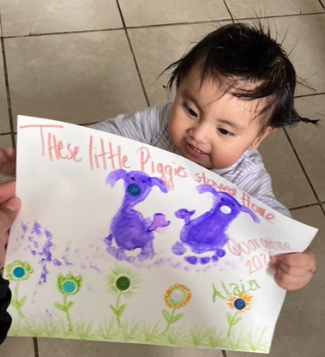
Family Support Center Response to COVID
Began home deliveries starting on March 24th
Continued instruction and services remotely
Use every available resource to continue to motivate and incentivize participation from our students

Slide 7
Transition from in person learning to remote learning
Participants began to feel isolated.
Students were overwhelmed with caring for children while trying to learn.
Staff struggled with keeping participants engaged.
This resulted in staff developing a way to provide a reward for participation in services and incentive to increase those participation rates - The Baby Boutique

Slide 8
Baby Boutique
Established in August 2020 as an incentive program for our teen and young parents to encourage participation in educational instruction.
Creates virtual groups and activities hosted by the AFSC.
Participants earn points for each group or activity they attend which are then “cashed in” for baby items, snacks and personal products.
Reward items are then delivered to participants during bi-weekly regular deliveries.

Slide 9
Baby Boutique Success
With the implementation of the Baby Boutique participation rates have increased.
Three parents have cashed in points for the Baby Boutique thus far and one had enough points to “purchase” a highchair for her daughter.
At this time 16 out of 28 parents have currently earned points ranging from 30-320 and the numbers are continuing to grow.

Slide 10
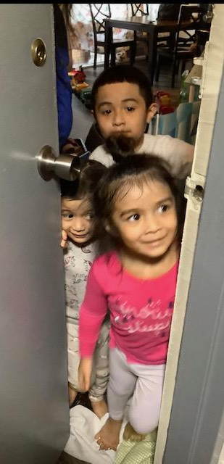
Participant Perspective
“They (staff) always ask what we need and let us know they are here to help us. I learn many new things everyday! My daughter and I learn to communicate with each other, have fun together and I really enjoy being in the program.”
- Lleryln, TPAP program participant
“The Family Support Center doesn’t just teach and show us how to treat our kids; they also show us how to have fun with them.”
- Markell, TPAP program participant

Slide 11
Special Thanks to Our Community Partners
Walk the Walk Foundation (diapers, wipes, formula)
Gloria Dei Lutheran Church in Arnold
Helping Hands of America Emergency Pantry
Caring Cupboard
Food Rescue (donated formula)
Feed Anne Arundel
Rachel Swan, Development Leader at The Church of Severn Run
Annapolis Pregnancy Clinic
Dental Dept.- Anne Arundel Department of Health(toothbrushes)
Delta Sigma Theta Sorority Inc. (personal items/hygiene kits)

